Slide 1
Stateful/Stateless/Virtual Actors
Підготували студенти групи ПМІ-52:
Міштурак Назар
Малашняк Павло

Slide 2
Agenda
Stateful
Stateless
Stateless Web Services
Actor
Actors and messaging
Supervisor and workers
Project ‘Orleans’
Virtual Actor

Slide 3
Stateful
Stateful - application that keeps internal state in memory or runtime, instead of relying on external services.
Examples: actors can be stateful, so actor-based systems (Erlang/OTP, Orleans, Akka) can be stateful.But it’s also possible to create stateful application in Node.js or Python.

Slide 4
Stateful
shorter messages
better performance (info in memory until closed)
open/close at server
file locking possible
read ahead possible

Slide 5
Stateless
Stateless - application that doesn’t keep any state in memory or runtime, but uses external services instead.
External services: database, cache, API, etc.
Examples: most of web apps are stateless or designed to be stateless (Spring, Django< Rails< Express, etc.).

Slide 6
Stateless
requests are self-contained
better fault tolerance
open/close at client
no problem of client crashes

Slide 7
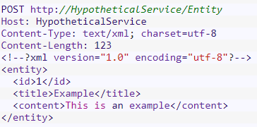
Stateless Web Services

Slide 8
Actor systems
An actor is a computational entity that, in response to a message it receiver can concurrently:
send a finite number of messages to other actors
create a finite number of new actors
designate the behaviour to be used for the next message it receivers
There is no assumed sequence to the above actions and they could be carried out in parallel.
Every actor has a mailbox, a supervisor and, optionally, some state.

Slide 9
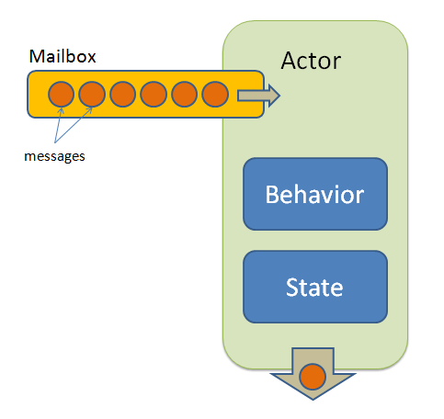
Actor
Lightweight Object
No Shared State
Messages in Mailbox
Messages are processed in order
Only one message at a time

Slide 10
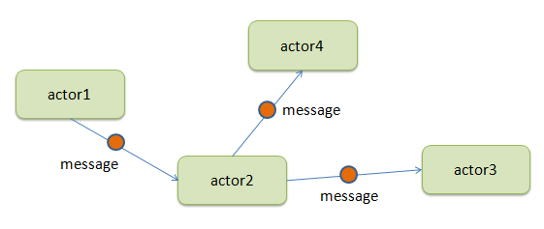
Actors and messaging

Slide 11
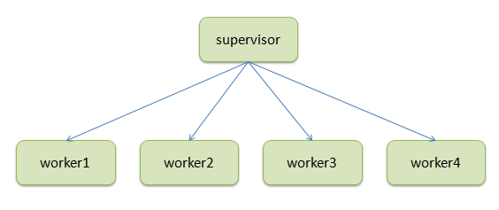
Supervisor and workers

Slide 12
Project “Orleans”
.NET Implementation of an Actor Model
Goals:
Provide easy-to-use distributed computed model for developers
Provide deployment model scaling from one node to a high-scale Azure cloud service
Developed by Microsoft Research and the open source community
Introduced the Virtual Actor Model

Slide 13
Virtual Actors
The main benefits of virtual actors are:
Perpetual existence
Automatic instantiation
Location transparency
Automatic scale out

Slide 14
References
https://dev.to/samueleresca/developing-apis-using-actor-model-in-aspnet-core-2oh2
https://www.microsoft.com/en-us/research/wp-content/uploads/2016/02/Orleans-MSR-TR-2014-41.pdf
https://nordicapis.com/defining-stateful-vs-stateless-web-services/
https://docs.microsoft.com/en-us/azure/service-fabric/service-fabric-reliable-services-quick-start

